Slide 1
ÇATALBURUN Turkish Pointer
H.Göksel DİLEK
TÜRKİYE

Slide 2
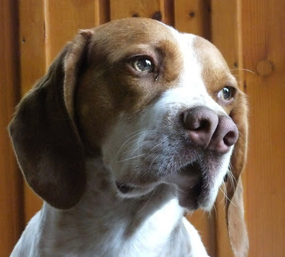
Çatalburun, known as one of the Turkish dog breeds on the world, or Turkish Pointer ‘, also known as Turkish Pointer’, is only known in the Tarsus region.

Slide 3
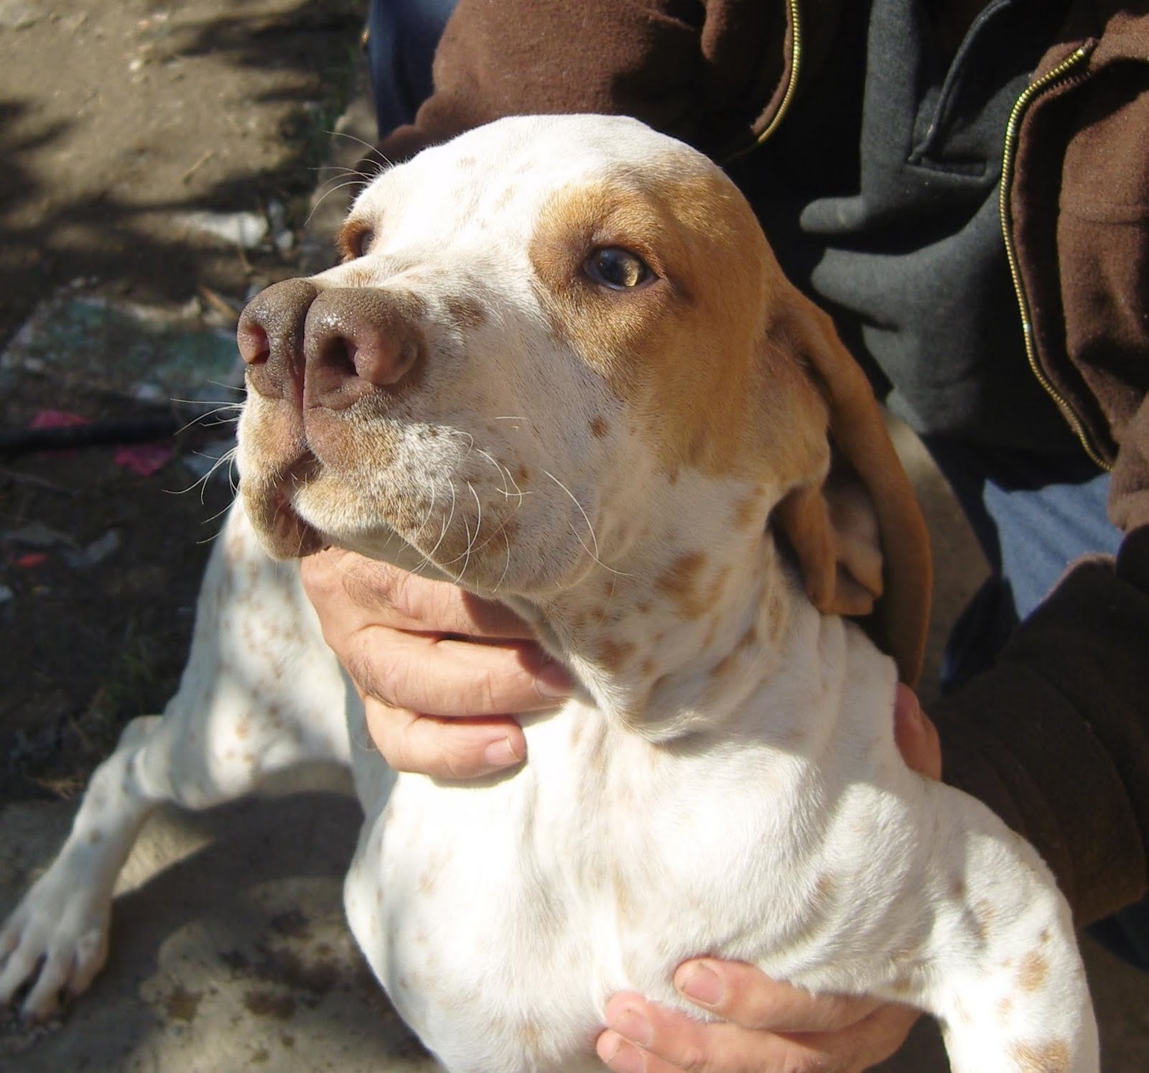
Here is the introduction of Tarsus Çatalburunlar which is used as a private hunting dog in recent years and as a legend, which is called as legend with its superior qualities.
This dog is a very cute and faithful
hunter dog.

Slide 4
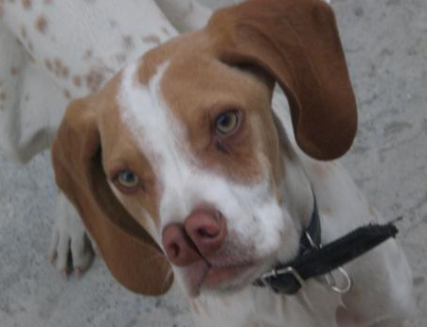
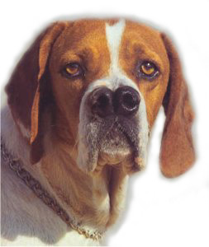
The most important feature of these cute dogs, one of the symbols of Tarsus, is that they are so mobile that they turn their heads. So it's hard to take pictures. He looks like a kid who looks mischievous. Especially when they get attention, they don't play.

Slide 5
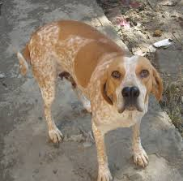
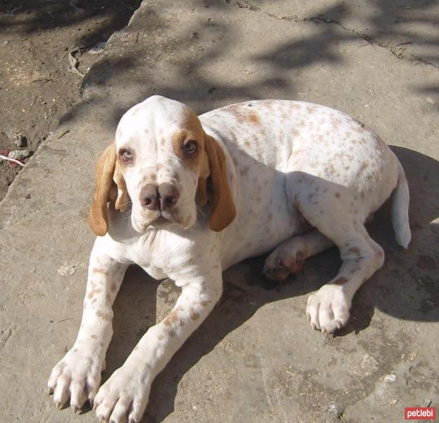
Çatalburun dogs usually have fine brown and bright hair.

Slide 6
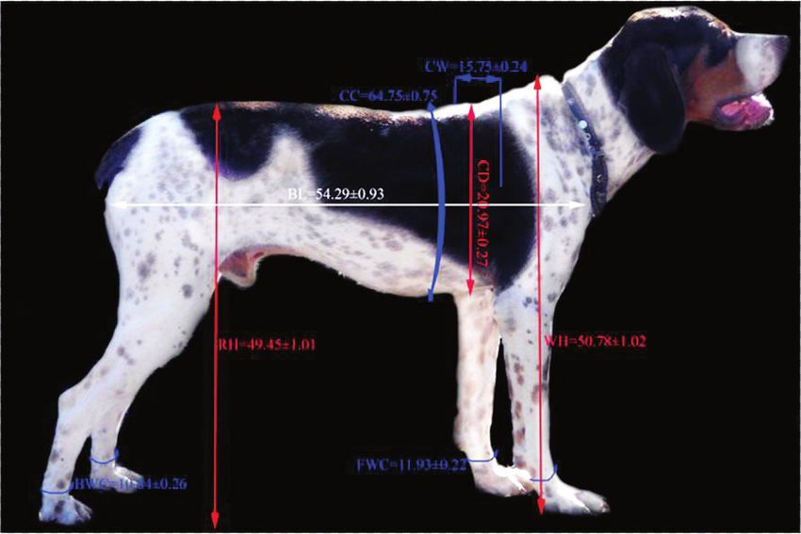
Physical Properties

Slide 7
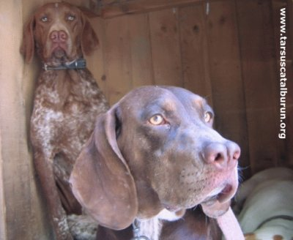
History and Origin
Turkish Pointer is known as a citizen of the country, today they are estimated to remain 200 units of them are under protection by the municipality.
Since the breeding of the Çatalburun in the official sense is not done, it is not mentioned in the official lists
Forks are obedient, obedient dogs not promised by their owners. These dogs are very calm dogs, so they are more preferred as home dogs.

Slide 8
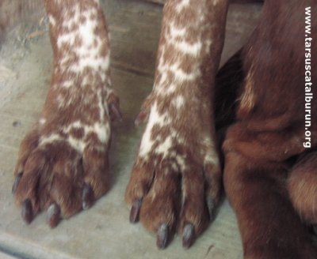
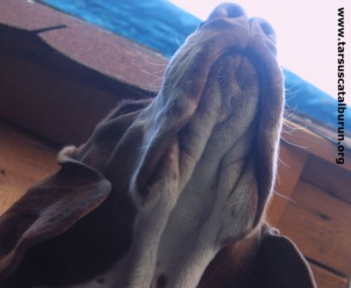
feet and head structure

Slide 9
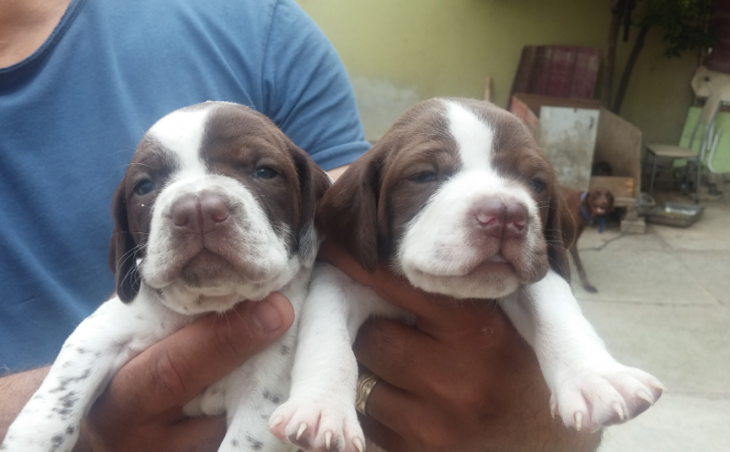
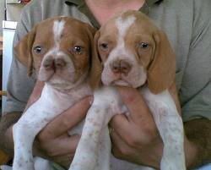
puppies are so cute

Slide 10
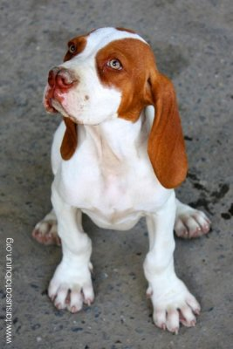
Because of their origins, they need a job to prevent boredom and unwanted behaviors. Because she is a working dog, so is not typically recommended for new dog owners or small family homes. If considering this dog breed for a residential or city environment consider these two important factors: You will need a safe, closed area to training your dog, specifically 6-foot fences with deep foundations; to prevent digging and jumping. Like other livestock guardian dogs, they bark an awful lot.
Important informations

Slide 11
Thanks for reading our presentation.
H. Göksel DİLEK...
Different breed - the same love

